Slide 1

FYP 2nd Evaluation
Sensor Integrated System based Real Time and Online Monitoring for Organ on Chip platforms
Group member 1:
Wakeel Ahmed (033-19-0026)
Group member 2:
Muhammad Saqlain (033-20-0011)
Group member 3:
Faizan Ahmed (033-20-0032)
Supervisor:
Dr. Fida Hussain Memon

Slide 2
Outline
Block Diagram
UART (Universal Asynchronous Receiver/Transmitter)
Reason to develop Installer for LabVIEW Applications
Difference between Installer and EXE (Executable File)
LabVIEW Installer for NI myRIO
Interfacing PCB with Amperometric Glucose Sensor
Work in Progress
Objectives
Bill of Materials

Slide 3
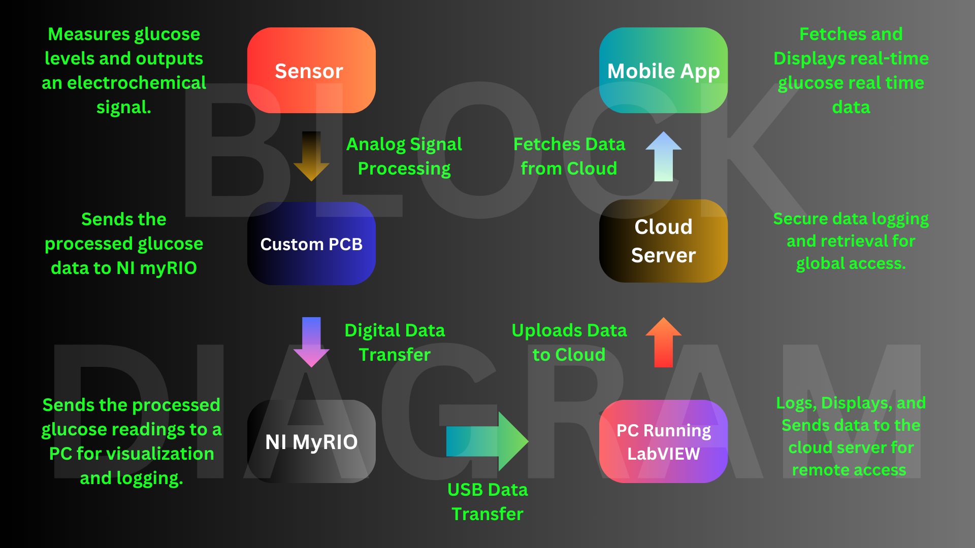

Slide 4
Objectives
Develop a hardware-software system for real-time microphysiological data acquisition.
Integrate sensors with PCB and NI myRIO for continuous data collection and processing.
Design a software interface for real-time data visualization and system control.
Enable online monitoring via a PC and Android app for remote access.
Conduct testing to ensure accurate data acquisition and reliable remote monitoring.

Slide 5
Bill of Materials
Dr Fida

Slide 6
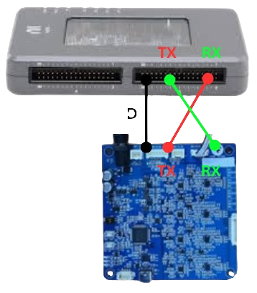

UART (Universal Asynchronous Receiver/Transmitter)
Full-duplex communication (simultaneous transmit and receive).
Uses TX (transmit) and RX (receive) lines.
No clock signal required; synchronization via start and stop bits.
Configurable baud rates (e.g., 9600 bps, 115200 bps).
Enables communication with external devices like sensors, microcontrollers, and PCs.

Slide 7
Reason to develop Installer for LabVIEW Applications
Includes All Dependencies: Bundles LabVIEW runtime, drivers, and libraries to avoid errors.
System Configuration: Automatically sets up shortcuts and environment settings.
Professional Look: Makes the application appear polished and reliable.

Slide 8
Difference Between Installer and EXE (Executable File)
Installer
What it does: Prepares the computer to run the program.
Includes: All the extra files the program needs, like drivers and shortcuts.
EXE (Executable File)
What it does: Runs the program directly.
Limitations: Might not work if the computer is missing important files it needs (like drivers or libraries).

Slide 9
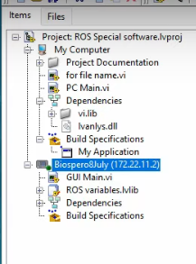
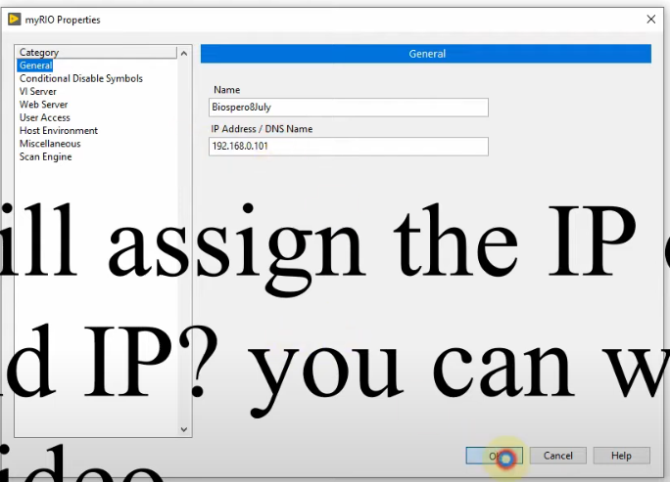
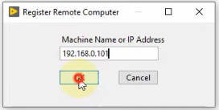
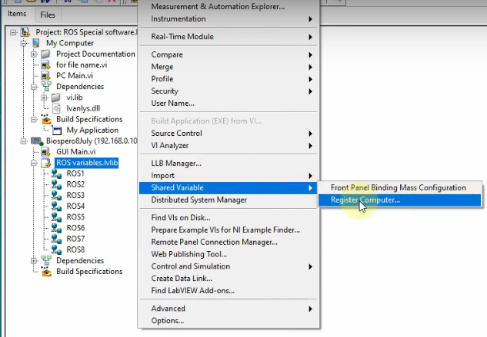
Creating a LabVIEW Installer for NI myRIO
Step 1: Assigning an IP Address to myRIO
Step 2: Registering the IP Address of myRIO

Slide 10
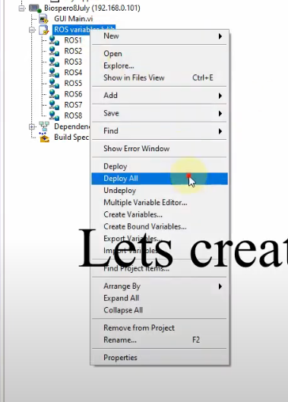
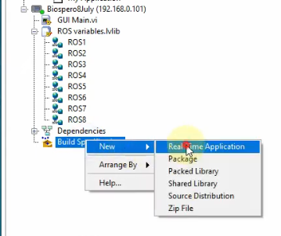
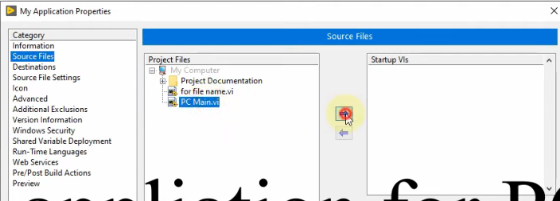
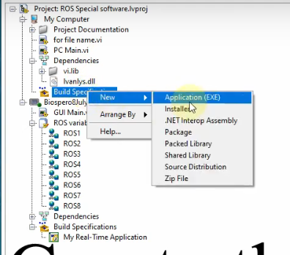
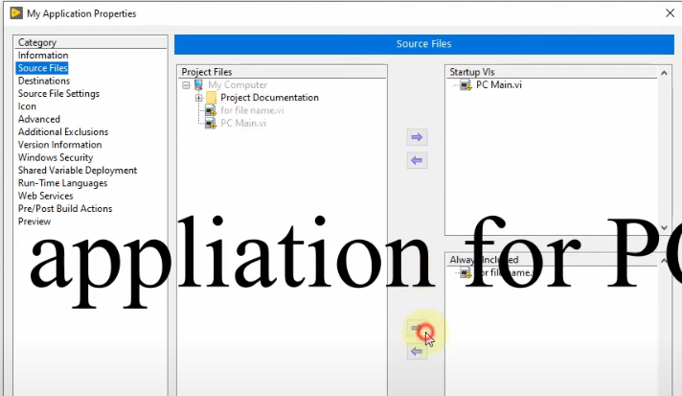
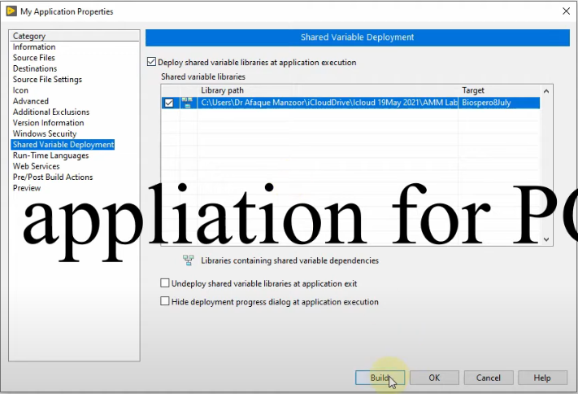
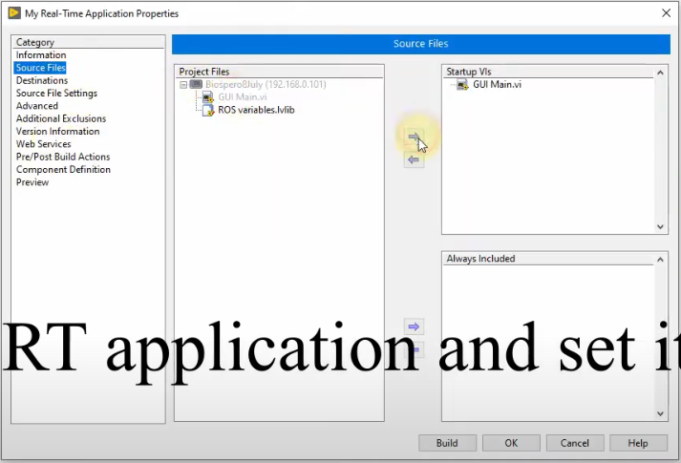
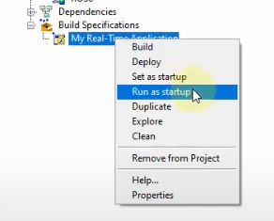
Creating a LabVIEW Installer for NI myRIO
Step 3: Create a Real-Time Application and Set it as Startup
Step 4: Create an Application for the PC Program

Slide 11
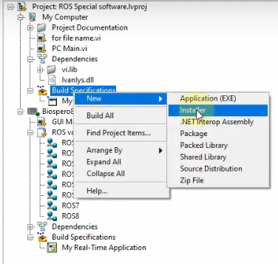
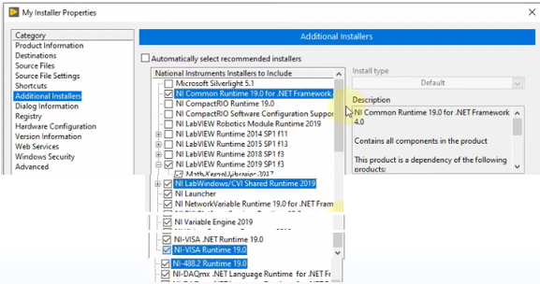
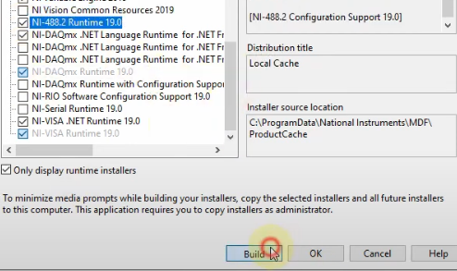
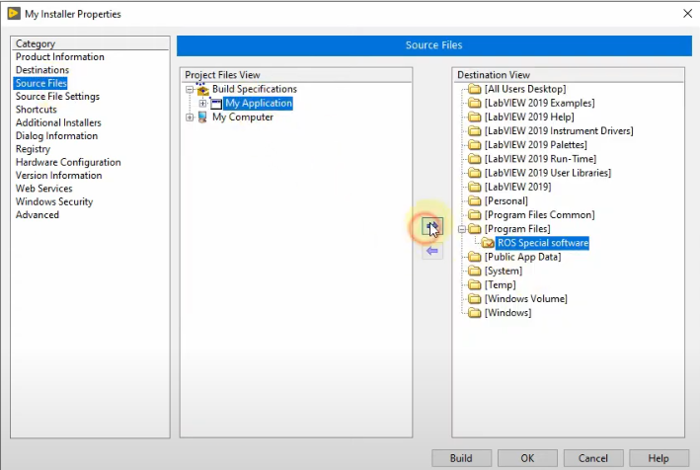
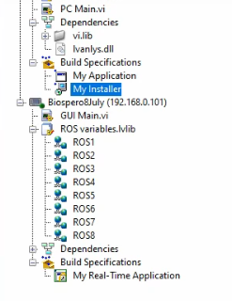
Creating a LabVIEW Installer for NI myRIO
Step 5: Create the Installer for Deployment
Step 6: Manually Select Required Tools
So, this is your software, that you can install anywhere... but the IP has to be above one. If you want to connect NImyrio somewhere else, then you should add the IP and make the software again.

Slide 12
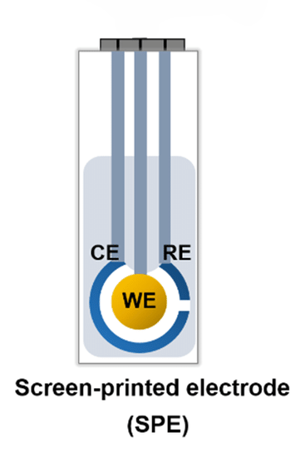
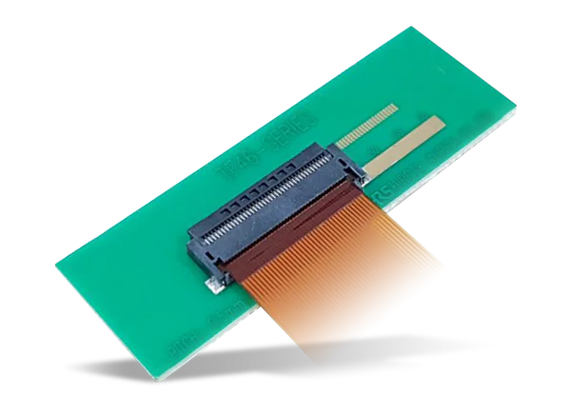
Interfacing PCB with Amperometric Glucose Sensor
Type: Amperometric three-electrode glucose sensor (Screen-Printed Electrode - SPE)
Application: Designed for real-time and continuous glucose monitoring
Working Electrode (WE): Carbon, Gold, or Platinum (customizable) (detects glucose oxidation, generating an electrochemical signal.)
Reference Electrode (RE): Silver/Silver Chloride (Ag/AgCl) (maintains a stable potential)
Counter Electrode (CE): Carbon or Platinum (allowing current flow between WE and RE)
Use a Zero Insertion Force (ZIF) connector to interface the sensor

Slide 13
Actual Set up
3 or 4 pictures
Specs of Sensor
Data Sheet of Sensor
By Dr Fida

Slide 14
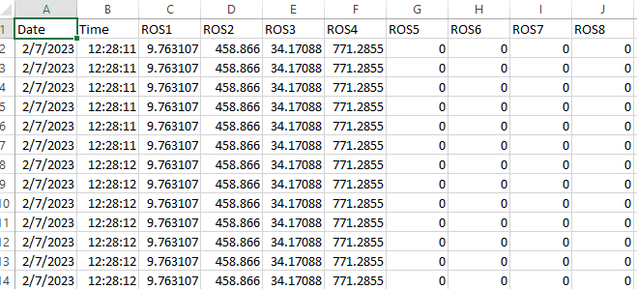
Work in progress
Testing with different glucose concentration samples(Outsourced).
Implementing graphical visualization for live glucose data tracking with real-time analysis, monitoring, and global accessibility.

Slide 15
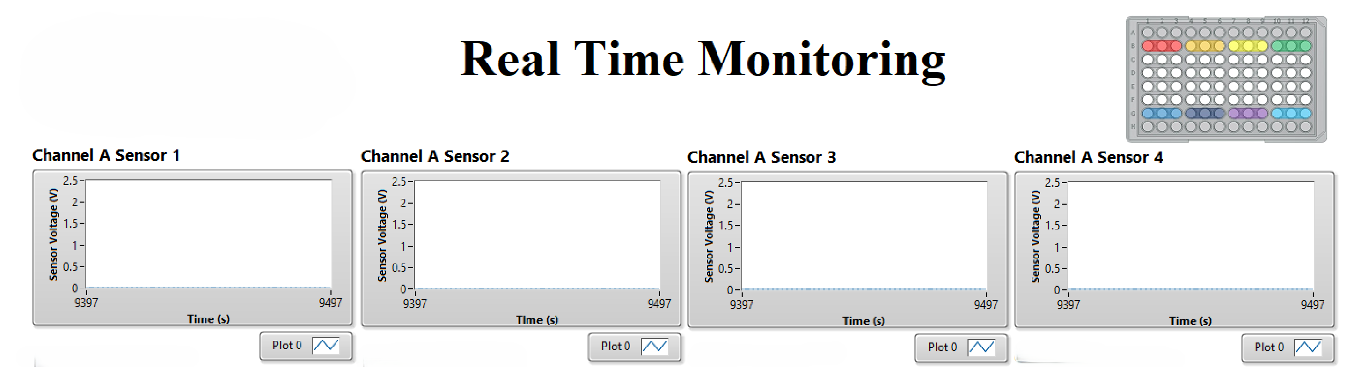
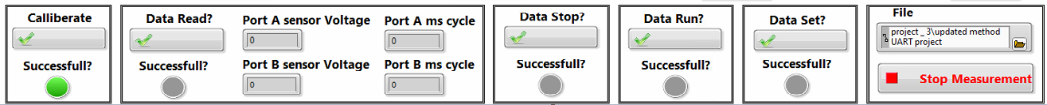
Graphical pictures of software and results

Slide 16
Thank You! Feedback and Questions

